Slide 1
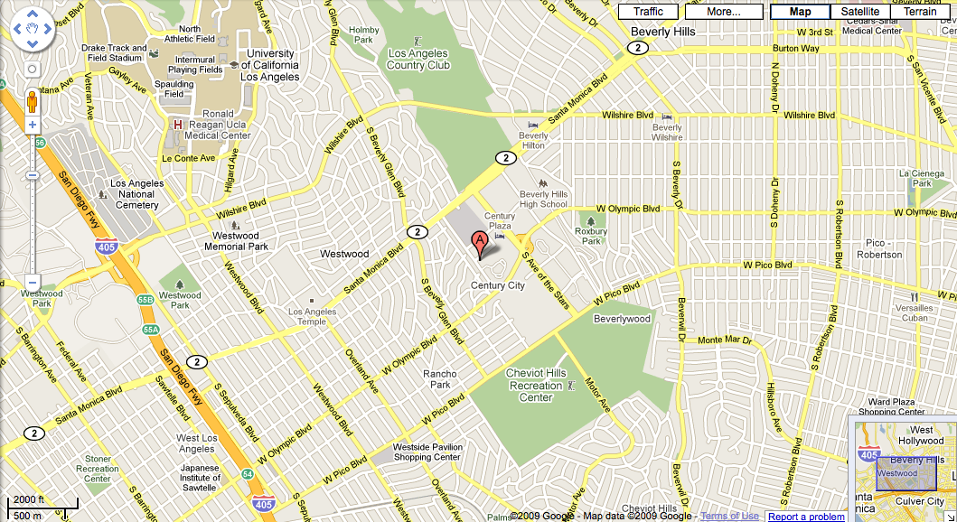
Local Media SEO: Don’t Give Google The NoIndex Finger!
Andrew Shotland
LOCAL SEO GUIDE
Local Search Engine Optimization & Monetization Made Simple
www.localseoguide.com | andrewsho@yahoo.com | 310.902.7370

Slide 2
Notes:
Pic of the Scream
When I read about the local media industry I often get a picture in my head
And then I start thinking about the opportunity I see and I get a slightly different picture

Slide 3
G
Notes:
Pic of a beautiful landscape with GOOG, Y & B But the local SEO world is getting crowded. Every day it seems like there are new players.

Slide 4
Notes:
Pics of Elocal, OrangeSoda, Hubspot, LocalSplash, DavidMihm, Me, Mike Blumenthal, Will Scott, ReelSEO, ExactFactor, etc
SMBs are getting savvier thanks to big SEO agencies and thousands of small local SEO experts

Slide 5
Notes:
Pics of Yelp, SuperPages, YellowPages, Yahoo Local, Merchant Circle, Local.com The Big Local sites are getting bigger and a focus on S E O is one of the key drivers

Slide 6
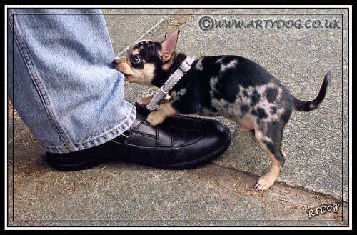
Notes:
Picture of Anklebiter - Yellowbot, HotFrog, AmericanTowns,Discoverourtown,Mojopages, CitySquares, Brownbook, GetFave, BestoftheWebLocal,MyPartyPlanner, LoadedWeb, Outside.in, Demand Media etc. And there are hundreds, maybe thousands of upstart local directory and local news sites competing for traffic

Slide 7
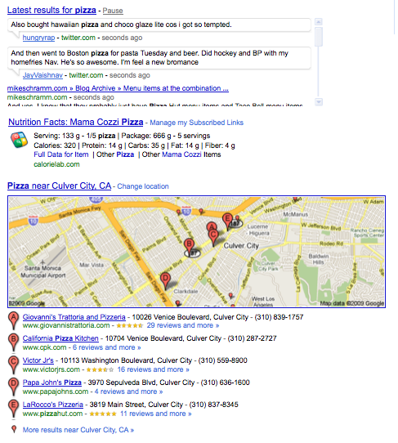
Notes:
Pic of eCPM chart from Adsense
There is a growing awareness that local search eCPMs are some of the highest on the web

Slide 8
How To Compete
Reviews
Vertical Guides
Answers
Video
Coupons
API

Slide 9
Know The Value of Keywords… & How To Rank For Them
Los Angeles DWI Attorney: $40.51 CPC
Tiger Woods: $ 0.58 CPC
Notes:
eCPM of lead headline for LATimes, ecpm of Los Angeles DUI Attorney

Slide 10
Trends & Seasonality
Notes:
Pic of Google Trends

Slide 11
Notes:
Pic of Skunk

Slide 12
As William Randolph Hearst Said
“Putting out a newspaper without promotion is like winking at a girl in the dark -- well-intentioned, but ineffective.”
“In suggesting gifts: Money is appropriate, and one size fits all.”

Slide 13
LOCAL SEO GUIDE
Local Search Engine Optimization & Monetization Made Simple
www.localseoguide.com

